Slide 1
Webscraping listings on Bienici with selenium
Professor Minh Phan
Student: Edward Vrijghem

Slide 2
1. Methodology
Scraping information using selenium
Cleaning collected data using pandas
Visualization using Matplotlib

Slide 3
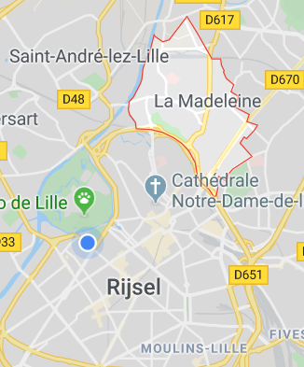
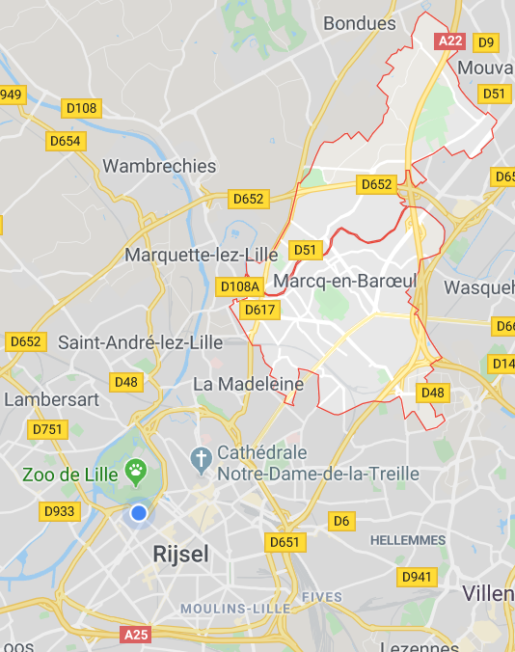

Slide 4
2.
Selenium

Slide 5
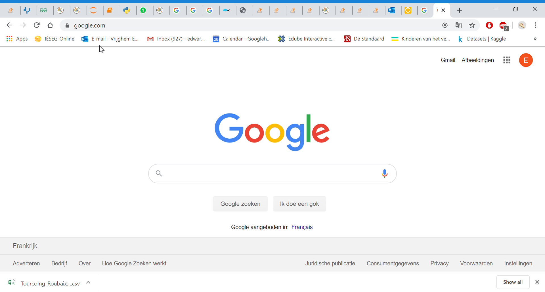
Scraping

Slide 6
Variables collected
Reference number
Municipality + postalcode + addressdescription
Listing Price + Price/m² + honorpaymentpercentage
Livingsurface in m²
Date of: Publishment, Modification
Heating
Amount of rooms, pieces
As dummies: Garden, parking, elevator, terrace, cellar

Slide 7
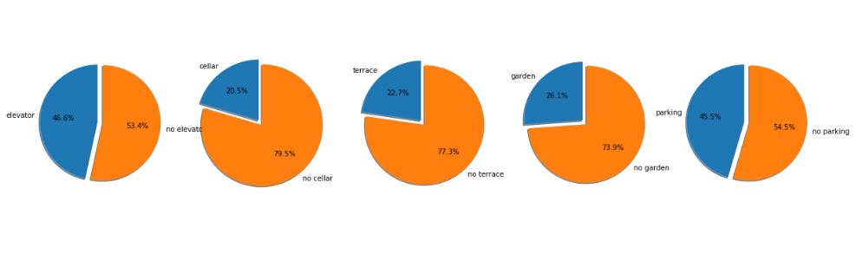
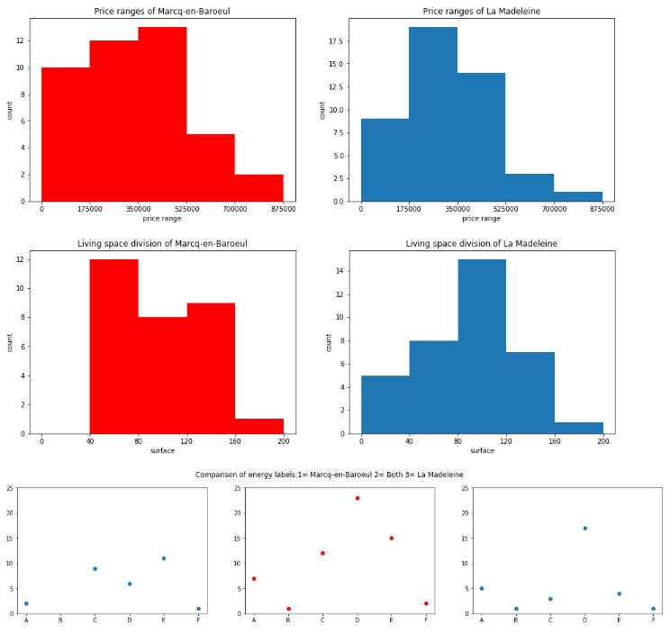
3. Dashboard

Slide 8
THANKS!
Any questions?

